Slide 1

IMDB MOVIE ANALYSIS
FINAL PROJECT-1

Slide 2

TABLE OF CONTENTS
01
05
Overview
Language Analysis
02
06
Technical Approach
Director Analysis
03
07
Tech Stack Used
Budget Analysis
04
08
Movie Genre Analysis
Insights
PAGE 02

Slide 3

OVERVIEW
The primary objective of this project is to investigate: "What factors influence the success/ratings of a movie on IMDB?".
The analysis involves analyzing the distribution of movie genres, distribution of movie durations, most common languages, influence of directors on movie ratings, relationship between movie budgets and their financial success
PAGE 04

Slide 4
Approach
Download the data and clean the data by handling missing values, removing duplicates, converting data types etc.
Create table, Pivot Table and Pivot Chart to analyze the data.
Solve the problem by using 5 whys approach
Clean and prepare data to summarize the findings.
PAGE 05

Slide 5

Data Cleaning
The first step before analysis is to clean the data by removing duplicate values from the provided data. In this particular sheet around 45 duplicate rows were present.
The next step is to remove incomplete data.
After the cleaning aroun3741 rows are remaining out of the 5041 rows of data provided.
PAGE 05

Slide 6

Movie Genre Analysis

Slide 7
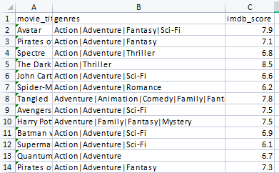
Movie Genre Analysis
Determining the most common genres of movies in the dataset.
To determine the most common genre we can use the COUNTIF function, as the genre column consists of more than one genre for each movie.
The countif funtion used is mentioned below:
=COUNTIF(B2:B3724,"*Action*")
Here the cells B2:B3724 contains the genre column
Based on the analysis we can understand that Drama and Comedy are the genre which has the maximum number of movies made.

Slide 8
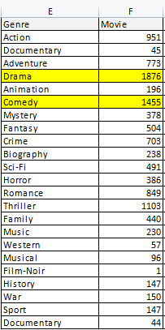
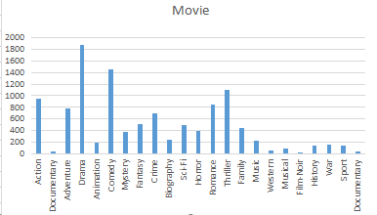
=COUNTIF(B2:B3724,"*Action*")
Here the cells B2:B3724 contains the genre column

Slide 9
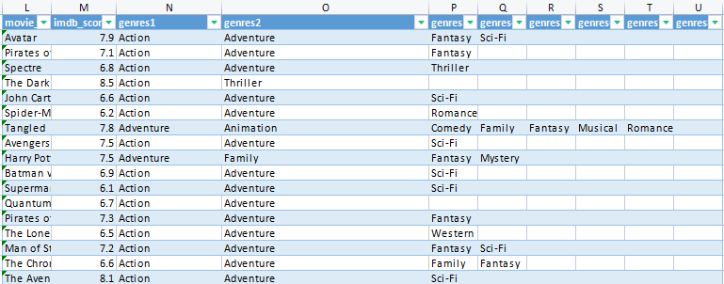
MEDIAN,MODE,RANGE,VARIANCE, STANDARD DEVIATION
To determine the median of the IMDB Scores we need to separate the genre column in to different columns. We can achieve that by using Text to Column function. After splitting the columns will look as shown below:

Slide 10


Median
To determine the median if IMDB Scores for each genre we need to consider all the genre columns. In that case we use Median with IF condition.
=MEDIAN(IF($R$2:$Y$3724=E2,$C$2:$C$3724))
Here cells N2 to U3724 denote the genres in for each movie title. E2 denoted each genre and cells c2:c3724 contain the IMDB scores.
Mode
Range
To determine the median if IMDB Scores for each genre we need to consider all the genre columns. In that case we use Mode with IF condition.
To determine the range we need to calculate MIN and MAX and subtract MIN from MAX.
=MAX(IF($R$2:$Y$3724=E2,$C$2:$C$3724))
=MIN(IF($R$2:$Y$3724=E2,$C$2:$C$3724))
=MODE(IF($R$2:$Y$3724=E2,$C$2:$C$3724))
Standard Deviation
Variance
To determine the median if IMDB Scores for each genre we need to consider all the genre columns. In that case we use Mode with IF condition.
To determine the variance we can use the variance sample formula with IF condition since all the genre columns are to be considered.
=STDEV.S(IF($R$2:$Y$3724=E2,$C$2:$C$3724))
=VAR.S(IF($R$2:$Y$3724=E2,$C$2:$C$3724))

Slide 11
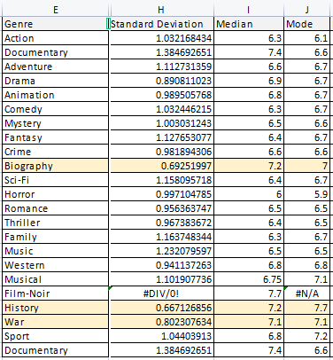
Functions Used
Median
=MEDIAN(IF($R$2:$Y$3724=E2,$C$2:$C$3724))
Mode
=MODE(IF($R$2:$Y$3724=E2,$C$2:$C$3724))
Standard Deviation
=STDEV.S(IF($R$2:$Y$3724=E2,$C$2:$C$3724))
Max & Min
=MAX(IF($R$2:$Y$3724=E2,$C$2:$C$3724))
=MIN(IF($R$2:$Y$3724=E2,$C$2:$C$3724))
Range
=VAR.S(IF($R$2:$Y$3724=E2,$C$2:$C$3724))
Conclusion
Based on the calculations done on movie genre it can be concluded that the Period Drama/History movies along with War sequences are found to have a higher IMDB ratings.

Slide 12
INSIGHTS
Based on the calculations done on movie genre it can be concluded that the Period , Drama, History movies along with War sequences are found to have a higher IMDB ratings, the Comedy genre is the next highest preferred genre.
Drama Films are serious presentations or stories with settings or life situations that portray realistic characters in conflict with either themselves, others, or forces of nature.
While, Comedy films are designed to entertain and make audiences laugh using humor, wit, and comedic situations to generate amusement.
Comedic films also often explore everyday situations and human foibles, providing a lighthearted escape for viewers while a dramatic film shows us human beings at their best, their worst, and everything in-between.
That being said there is a high element of personal connection that the audience can make to the characters in the film of these two genre, thus popularising these genre more than others.

Slide 13

MOVIE DURATION ANALYSIS
PAGE 06

Slide 14
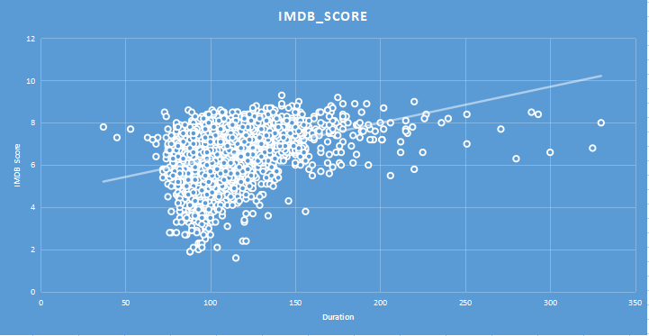
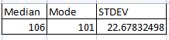
MOVIE DURATION ANALYSIS
Determining the relationship between movie duration and its impact on IMDB Score
To determine the impact of movie duration on the IMDB Score, we need to calculate the mean, median, and mode. The formulas used are as follows:
=MEDIAN(B2:B3724)
=MODE(B2:B3724)
=STDEV.S(B2:B3724)
Here the cells B2:B3724 contains the duration column

Slide 15
INSIGHTS
Based on the calculation and the average time duration 106.
For the movies with time duration of 106, we have an average rating of 6.5.
As we can see from the scatterplot mapping the average time duration for movies are within the range of 90 to 120 range. But some movies outside these range also have a higher rating
Hence, while looking at the projection and the data it can be concluded that though there doesn't seem to be any direct connection between the movie duration and its score, it can still have some affect indirectly.
For example in case where the production/theme/execution or direction of the movie was not upto standards then forcing the audience for a longer movie duration will definitely have an impact on the rating

Slide 16

LANGUAGE ANALYSIS
PAGE 06

Slide 17
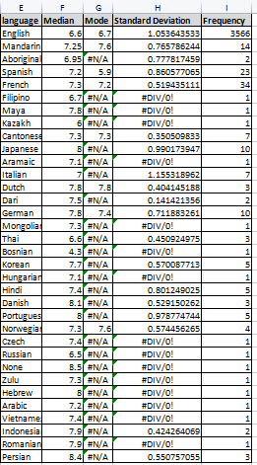
LANGUAGE ANALYSIS
Determining the most common languages used in movies and its impact on IMDB Score
To determine the impact of movie language on the IMDB Score, we need to calculate the mean, median, and mode. The formulas used are as follows:
=MEDIAN(IF($B$2:$B$3724=E7,$C$2:$C$3724))
=MODE(IF($B$2:$B$3724=E40,$C$2:$C$3724))
=STDEV.S(IF($B$2:$B$3724=E7,$C$2:$C$3724))
Here the cells B2:B3724 contains the language column.
And the cells C2:C3724 contains the IMDB Score.

Slide 18

INSIGHTS
English is the most spoken language in the world. And Mandarin Chinese is the second largest right after English
English-language films often have a broader international reach due to their wide distribution and global appeal. This can positively impact IMDb scores, as more viewers from different countries can access and rate the films.

Slide 19

DIRECTOR ANALYSIS
PAGE 06

Slide 20
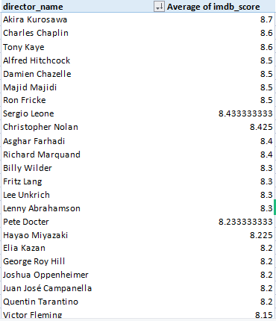
DIRECTOR ANALYSIS
Determining the influence of directors on movie ratings.
To determine top directors based on their average IMDB score and analyze their contribution to the success of movies using percentile calculations. The steps for the same are as follows:
Create a pivot table with director names as rows and average of IMDB Scores in the corresponding values column.
Sort the data in descending order of the IMDB Score Average.

Slide 21
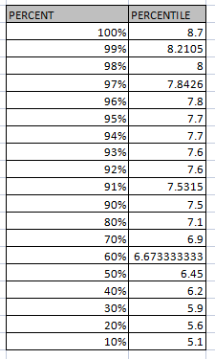
Determining the percentile of the IMDB Score Average
To analyze the contribution of top directors in the success of movies using percentile calculations. The formula used are as follows:
=PERCENTILE($M$5:$M$1663,P5)

Slide 22
INSIGHTS
As we can see, by using the percentile function, the imdb score of 8.7 is at 100th percentile ranking.
And at 99 percentile the score changes to 8.2105.
The range of scores between these boundaries contain a wide range of directors, including directors like
Christopher Nolan who has around 8 films directed by each within the range of 7.2 to 9 and Akira Kurosawa, Elia Kazen have only one record each.

Slide 23

BUDGET ANALYSIS
PAGE 06

Slide 24
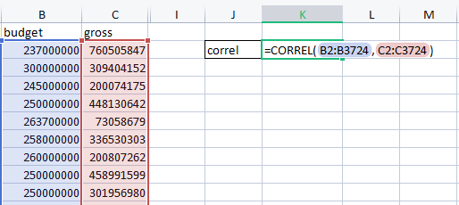
BUDGET ANALYSIS
Determining the relationship between movie budgets and their financial success.
To analyze the correlation between movie budgets and gross earnings, and to identify the movies with the highest profit margin. using CORREL and MAX function. The function for the same are as follows:
=CORREL(B2:B3724,C2:C3724)
The CORREL function returned the value as 0.09831, which indicates that the CORREL is neither positive nor negative. Thus concluding that there is no correlation between the budget of the film and its gross earnings

Slide 25
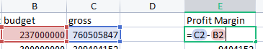
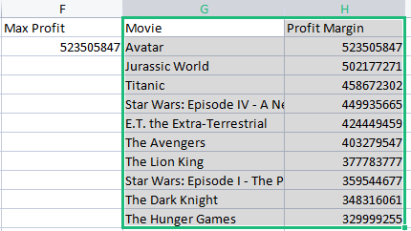
Determining the profit margin
The profit margin is caculated by subtracting the movie production budget from the gross earnings.
The formula is
Profit Margin = (gross - budget)
The MAX function returns the maximum profit margin.
The column F as shown in the image shows the maximum profit margin.
The columns G and H show the top 10 movies with highes profit margin.

Slide 26
INSIGHTS
The CORREL function returned the value as 0.09831, which indicates that the CORREL is neither positive nor negative.
Thus concluding that there is no correlation between the budget of the film and its gross earnings.
Though the higher production amount can improve the movie goers averall experience, the factors like story, storytelling, subjectivity, direction, casting, talent make a significant part on the gross earnings of the movie.

Slide 27

RESULT
The scores on IMDb are subject to the influence of a diverse range of factors, encompassing the quality of storytelling, acting prowess, direction, production values, and the level of engagement exhibited by the audience. Using on the 5 why approach we decipher the conclution of the analysis
Why is Drama the most popular genre ?
Based on the analysis it was found that Drama is the most popular genre followed by comedy. Both these genre have a high element of personal connection to the audience thus popularizing these genre more than others.

Slide 28
Why does movie duration not have any significant impact on the rating?
Why does movie budget not have any significant impact on the profit?
Looking at the scatterplot projection and the data it can be concluded that there doesn't seem to be any direct connection between the movie duration and its score, it can still have some affect indirectly.
If a movie's duration doesn't align with the genre's norms or with what viewers expect, it might lead to disappointment and potentially lower ratings.
Though the higher production amount can improve the movie goers averall experience, the factors like story, storytelling, subjectivity, direction, casting, talent make a significant part on the gross earnings of the movie.
Reference Excel: https://docs.google.com/spreadsheets/d/1gAq5sK8L2e7rCP0O0KaNo7gqx6tfnVQk/edit?usp=drive_link&ouid=101780150233328223923&rtpof=true&sd=true
Why is English the most prominent language in movie?
English-language is the most spoken language all over the world. Thus English films often have a broader international reach. This can positively impact IMDb scores, as more viewers from different countries can access and rate the films.

Slide 29


Thank You

